Slide 1
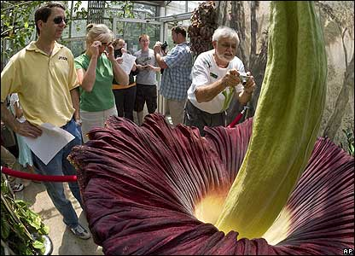
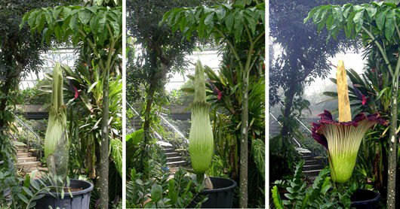
Spathe or leaf-like bract
Amorphophallus titanum
Largest unbranched inflorescence in the world
Monecious and protogynous
Carrion flower (fly/beetle pollinated)
Indigenous
to the forests
of Sumatra
Spadix
Notes:
1
Monecious = separated male and female flowers
protogynous = female flowers mature first
produces a single leaf. Grows from a corn, up to 200 pounds.
Open for 12-24 hours.

Slide 2
Questions
How is genetic variation distributed in time and space?
What factors account for the spatial and temporal distribution of genetic lineages?
Notes:
2

Slide 3
Phylogeography: Outline
What is phylogeography?
The benefits of phylogeography
i.e. understanding genetic structure
How do we do it?
From historical to current approaches
Notes:
3

Slide 4
Phylogeography: Introduction
What is phylogeography?
“A field of study concerned with the principles and processes governing the geographic distribution of genealogical lineages, especially those within and among closely related species.”
Avise 2000
Notes:
4
Relatively new field of study, coming of age with the development of better molecular and statistical tools.

Slide 5
Phylogeography: Introduction
Population genetics
Within populations
Shallow timescale
Phylogenetics
Between species
Deep timescale
Phylogeography
Between populations and species
Medium timescale
Plus geography
Notes:
5
Relatively new field of study, coming of age with the development of better molecular and statistical tools.

Slide 6
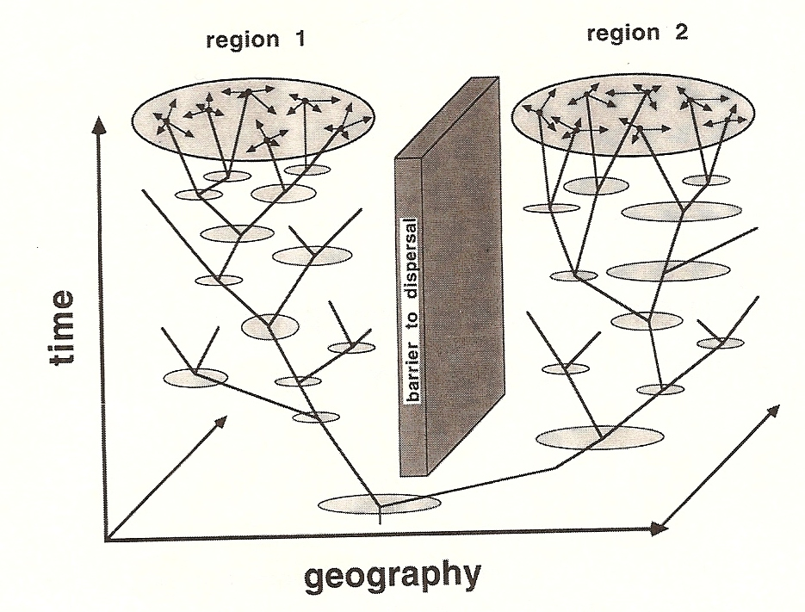
Phylogeography: Introduction
Gene genealogies of interest are mapped in space and time.
Avise 2000

Slide 7
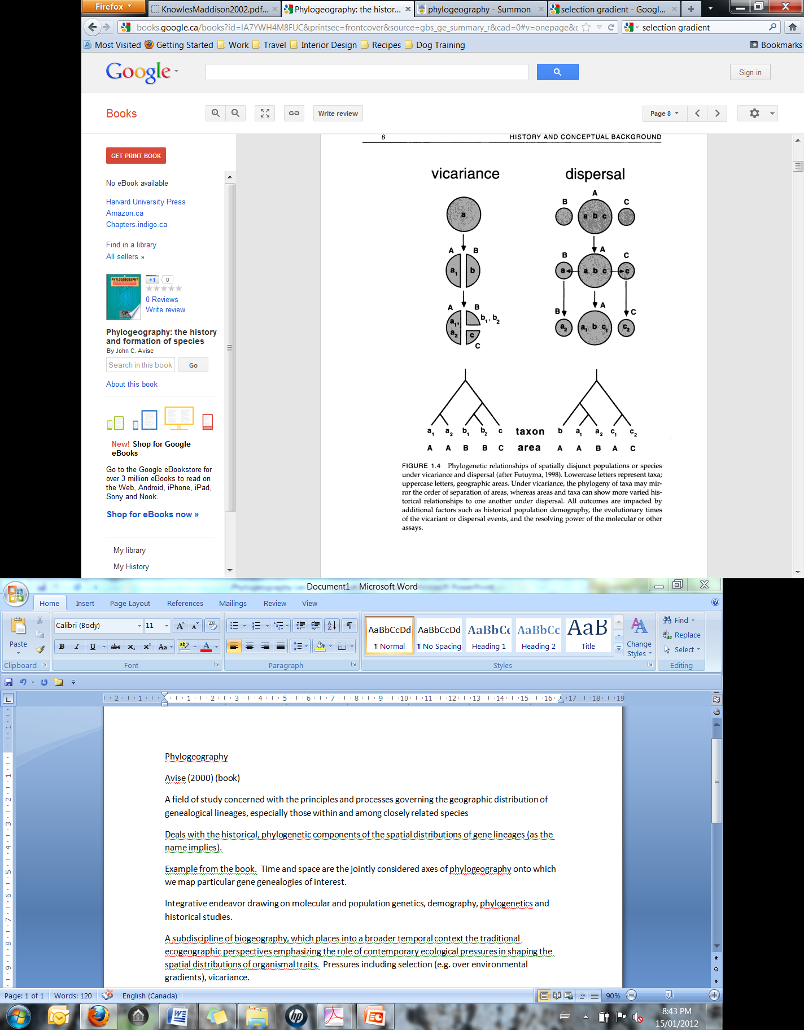
Phylogeography: Introduction
Goal: To understand the factors contributing to the formation of population (or species-level) genetic structure.
Can evaluate alternative historical scenarios that account for current spatial patterns.
Notes:
For example, vicariance and dispersal are two competing possibilities often invoked to account for the origins of spatially disjunct taxa. Phylogeographic analysis may be able to weigh these 2 possibilities. Under vicariance, the phylogeny of taxa may mirror the order of separation of areas, whereas areas and taxa can show more varied historical relationships under dispersal.

Slide 8
Determinants of Genetic Structure
Historical relationships and contemporary gene flow influence spatial patterns of genetic variation.
Similarity due to gene flow
Similarity due to historical relationships
Notes:
8
Gene flow levels are influenced by breeding system (e.g. oaks with no reproductive barriers and dandelions with apomixis) and dispersal mechanisms. Ancestry contributes to the genetic structure of all plant species to some extent… If genetic exchange is held constant, populations with more recent common ancestry will be more similar than those that are more distantly related.

Slide 9
Understanding
Genetic Structure
Traditionally:
Within species, genetic exchange has been emphasized as the cause of similarity.
Caveat: when estimating Nm, we assume an equilibrium between genetic drift and gene flow.
Among species, historical relationship has been emphasized as the cause of similarity.
Caveat: cladistics assumes non-reticulation.

Slide 10
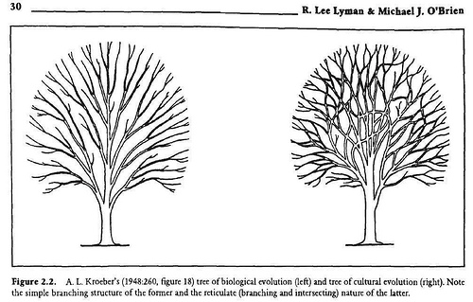
What is Reticulation?
Plant species boundaries are often porous (interspecific hybridization and introgression is common).
Populations form reticulating lineages (i.e. networks)
Notes:
10
So we know that neither of these two assumptions are appropriate… but these are fundamental to the application of population genetics and phylogenetics, respectively. How can we accurately tease the contribution of these two forces apart?

Slide 11
Understanding
Genetic Structure
“Phylogeographic methods provide a means of examining the history of genetic exchange among populations, with the potential to distinguish biogeographic patterns of genetic variation caused by gene flow from those caused by common ancestry.” - Schaal 1998
We can tease apart contemporary forces of genetic exchange from historical relationships
Notes:
11

Slide 12
Understanding
Genetic Structure
Phylogeography uses principles from population genetics and phylogenetics.
However…
Does not assume an equilibrium between drift and gene flow
2) Does not assume non reticulation
Relying on the use of gene genealogies, from non-recombining segments of DNA (e.g. mtDNA, cpDNA), phylogeographic methods provide historical information that individuals or populations cannot.
Notes:
12

Slide 13
Genetic variation
We need significant genetic variation at the appropriate level (i.e. among the populations or taxonomic units under investigation)
Mitochondrial DNA
-great for animals
-low rates of molecular evolution in plants, intramolecular recombination
Chloroplast DNA
-faster rates of molecular evolution but still low (and variable among species)
-no recombination
-chloroplast capture can occur (e.g. in oaks, sunflowers, poplar)
Organelle genomes are essentially a single locus - inferences based on multiple loci give more accurate estimations of the population history of a species
Nuclear DNA
-problems of intra-allelic recombination, heterozygosity and gene families
Notes:
13
Recombination can complicate the analyses, since we are essentially trying to follow haplotypes over time in gene genealogies. Haplotypes = particular combination of alleles (over multiple markers) on a single chromosome.
Nuclear DNA potentially has all the variation we need but…

Slide 14
Phylogeography: the early years
Phylogeography was essentially descriptive:
Plot haplotypes on map
Classify pattern of phylogeographic structure
Consider historical explanations
Look for concordance among different species (comparative phylogeography)
Notes:
14

Slide 15
Haplotype network
D
C
A
B
Notes:
15

Slide 16
Haplotype network
D
C
TGCCC
A
B
TGTCG
ATTCG
ATTAG
Notes:
16

Slide 17
What is the C haplotype?
D
C
TCTGG
A
B
TGACG
1. TGTGG
2. TGTCG
GGACG
3. TCACG
4. GGTGG
Notes:
17
What could confuse this situation?

Slide 18
What is the D haplotype?
D
C
A
B
TGTCG
TGACG
GGACG
Notes:
18
What could confuse this situation?

Slide 19
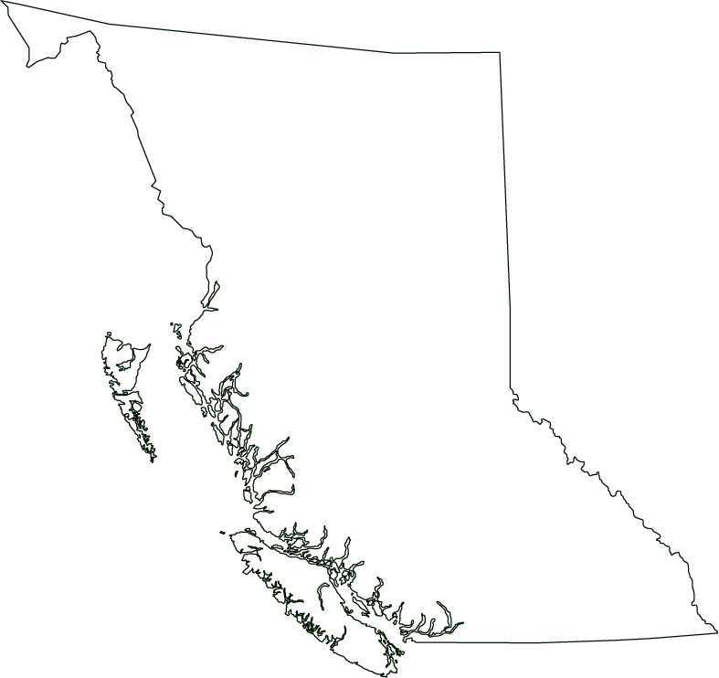
Where did C originate from?
C
A
C
B
B
A
Notes:
19
What could confuse this situation?

Slide 20
Deep divergence
A
B
B
A
Notes:
20
What could confuse this situation?

Slide 21
Shallow divergence
A
B
B
A
Notes:
21
What could confuse this situation?

Slide 22
Gene flow
A
B
B
A/B
Notes:
22
Which direction?

Slide 23
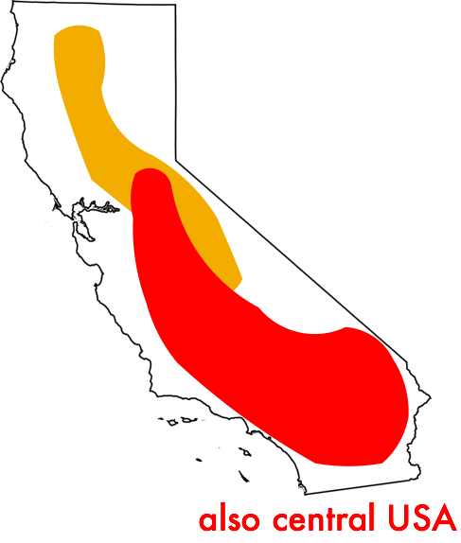
Detecting gene flow
H. annuus
H. bolanderi
Notes:
23
Which direction?

Slide 24
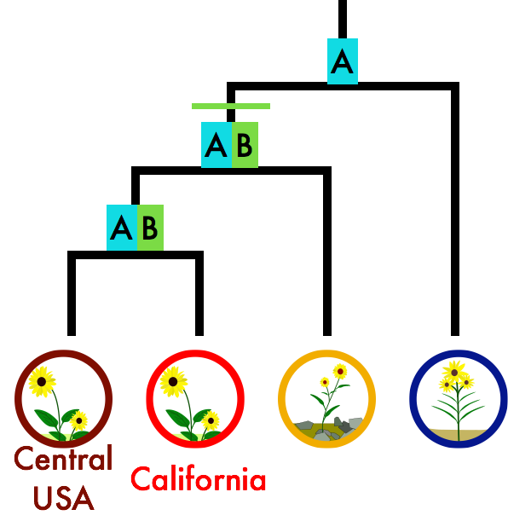

ABBA-BABA test
H. bolanderi
H. annuus
Outgroup
Notes:
24
Which direction?

Slide 25
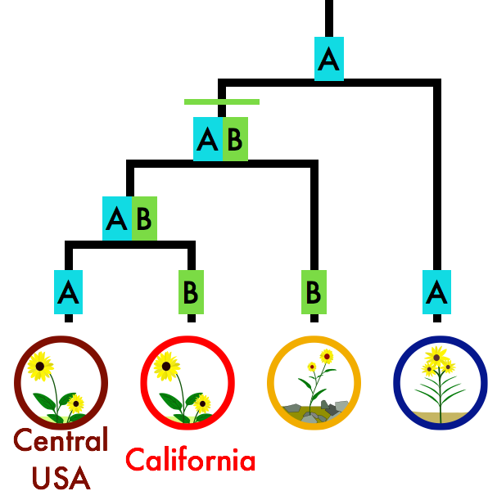
ABBA-BABA test
H. bolanderi
H. annuus
Outgroup
Notes:
25
Which direction?

Slide 26
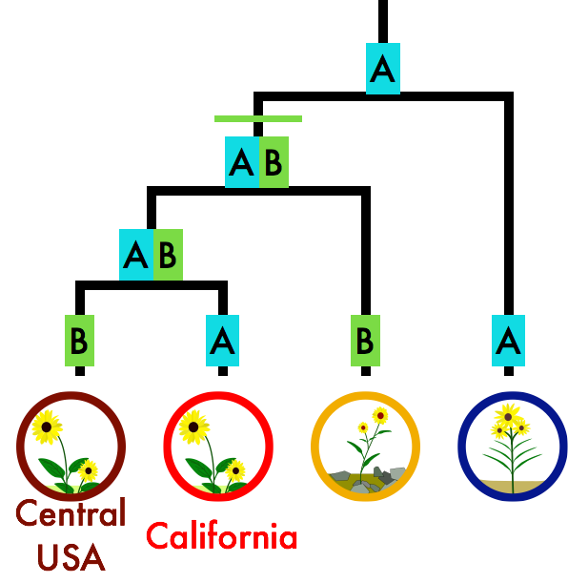
ABBA-BABA test
H. bolanderi
H. annuus
Outgroup
Notes:
26
Which direction?

Slide 27
ABBA-BABA test
D-statistic = #ABBA - #BABA
Neutrality: D = O
Gene flow: D = +
Notes:
27
Which direction?

Slide 28
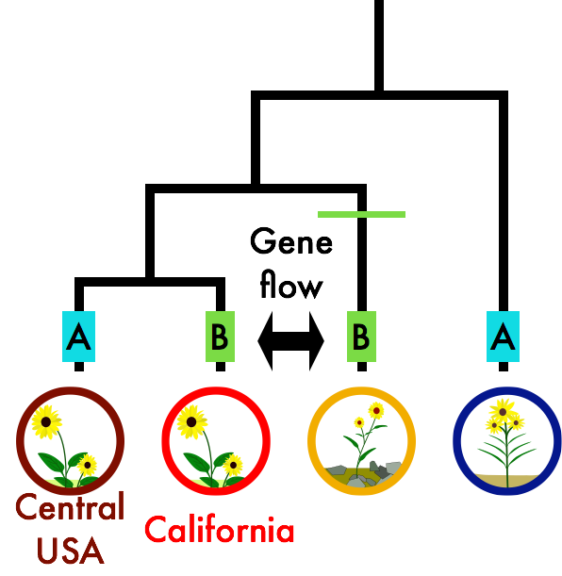
More ABBA under gene flow
H. bolanderi
H. annuus
Outgroup
Notes:
28
Which direction?

Slide 29
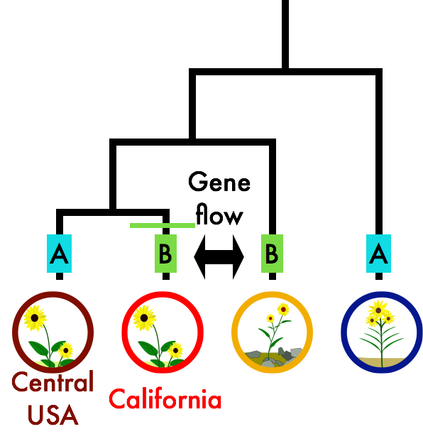
More ABBA under gene flow
H. bolanderi
H. annuus
Outgroup
Notes:
29
Which direction?

Slide 30
More ABBA under gene flow
H. bolanderi
H. annuus
Outgroup
Notes:
30
Which direction?

Slide 31
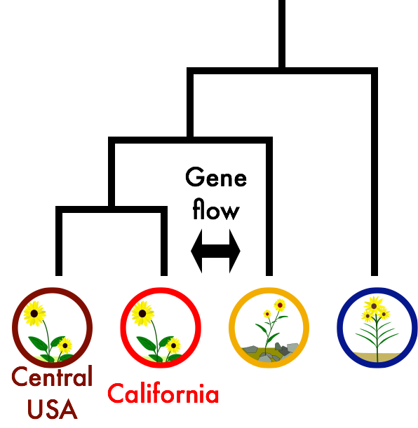
D statistic = 0.123 ± 0.033
ABBA > BABA
6-8% of the genome introgressed
H. bolanderi
H. annuus
Outgroup
Notes:
31
Which direction?

Slide 32
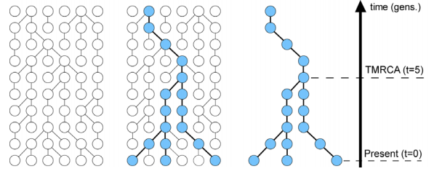
New Approach: Coalescent theory
A statistical framework for the analysis of genetic polymorphism data
Is an extension of classical population genetics theory
It is used to estimate time (number of generations) since lineages coalesced
Many applications
Notes:
32

Slide 33
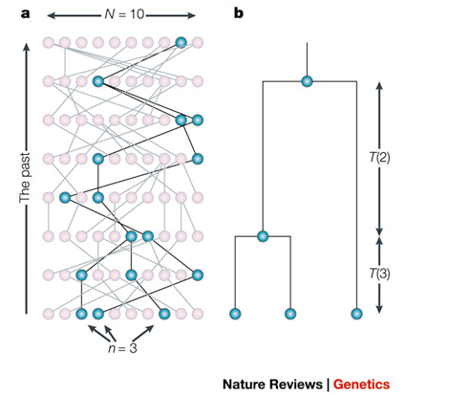
Coalescent theory
We go backwards in time from the present
Lineages can randomly “pick” their parents as we go back in time (no selection)
When two lineages pick the same parent they coalesce
All lineages will eventually coalesce to the MRCA of the sample
The rate that lineages coalesce depends on the number of lineages (more lineages the faster the rate) and the size of the population (the more parents to pick from, the slower the rate)
Recombination, gene flow and selection can be incorporated into the model
N number of alleles in the population
n number of lineages sampled
T time between coalescent events
Rosenberg & Nordborg 2002
Notes:
33

Slide 34
Conceptual distinctions
Classical population genetics
-based on allele frequencies
-alleles are either the same or different, no degrees of similarity
Phylogeography
-based on gene genealogies
-both the frequencies of sequence haplotypes and their relationship is considered
Coalescent Theory
-a mathematical approach to solving population genetic problems
-explicitly considers genealogical processes, even if the data are allele frequencies
Notes:
34

Slide 35
Model based methods
1. Collect data
Notes:
35

Slide 36
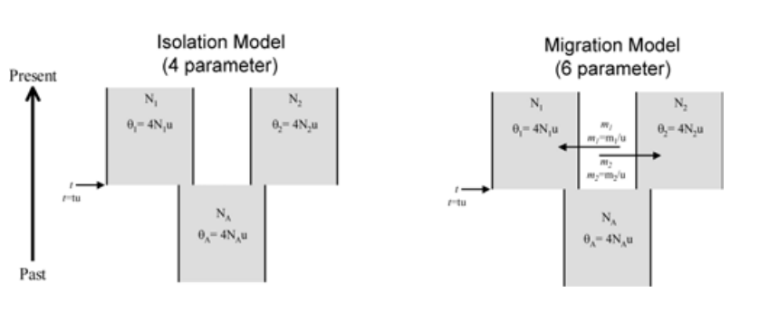
Model based methods
Collect data
Develop phylogeographic models
Notes:
36

Slide 37
Model based methods
Collect data
Develop phylogeographic models
Calculate likelihood support for models based on your data
Notes:
37

Slide 38
Model based methods
Collect data
Develop phylogeographic models
Optimize parameters based on your data
Calculate likelihood support for models based on your data
Pick best supported model
Notes:
38

Slide 39
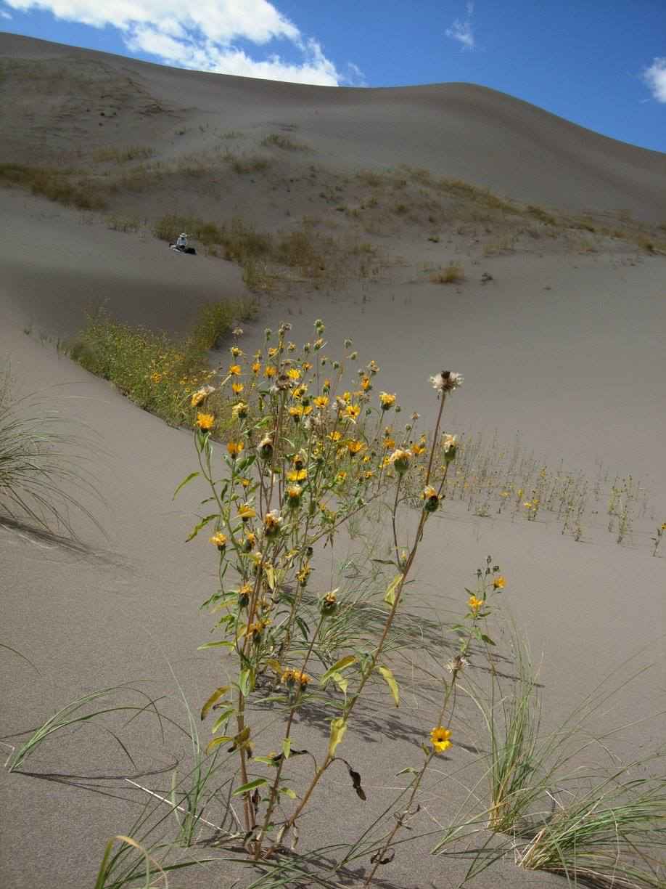
Model based methods
Dune and non-dune sunflower (Helianthus petiolaris)
Rose Andrew and Kate Ostevik
Notes:
39

Slide 40
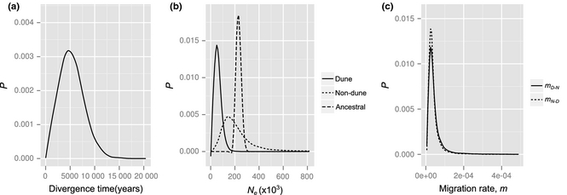
Model based methods
Notes:
40

Slide 41
Phylogeography: summary
Phylogeography's objective is to understand the processes underlying the spatial and temporal dimensions of genetic variation.
ABBA-BABA test detects gene flow.
Statistical phylogeography, relying of coalescent models, provides a rigorous statistical method to assess demographic hypotheses
Gene genealogies from multiple unlinked nuclear loci are required to provide a better historical record for species
Notes:
41

Slide 42
Unanswered questions
How much cryptic diversity exists in nature?
What is the phylogeographic history of ecological communities?
Notes:
42

